Slide 1

ISAAC CARILO (MPhil Student)-Molecular Cell Biology of Infectious Diseases

Slide 2
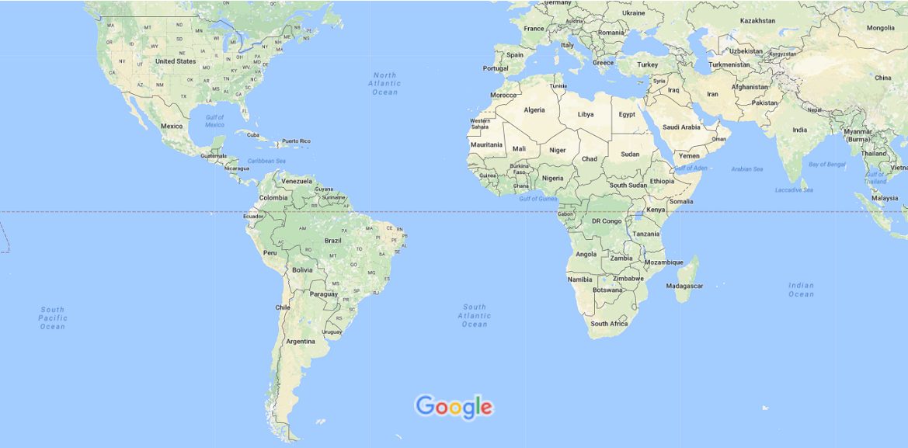
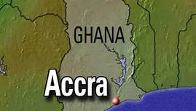
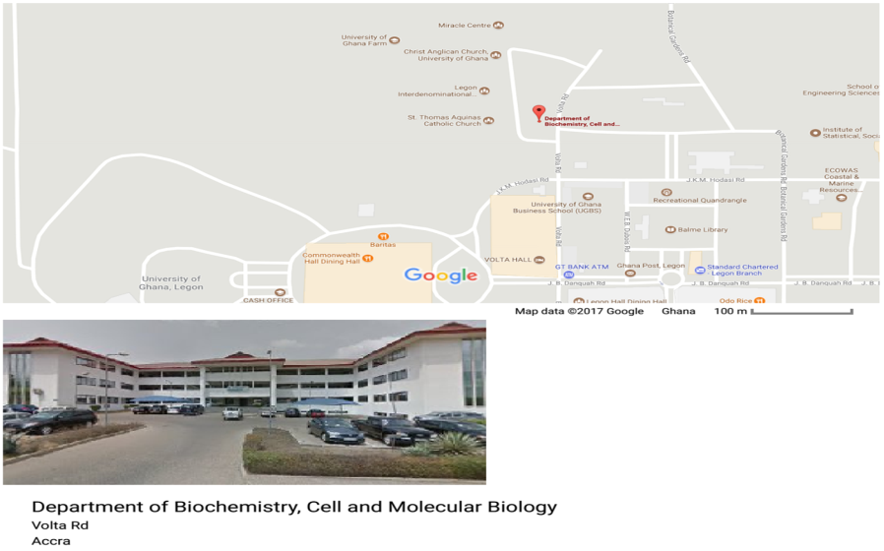

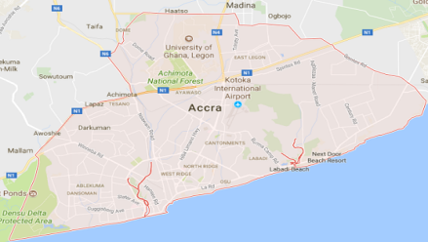
GEOGRAPHICAL LOCATION
WORLD MAP
DEPARTMENT OF BIOCHEMISTRY, CELL AND MOLECULAR BIOLOGY, UNIVERSITY OF GHANA
GHANA
ACCRA

Slide 3
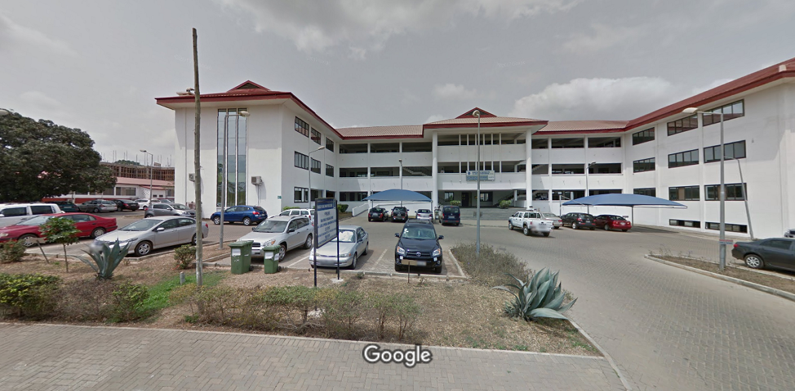
LONG TERM SCIENTIFIC GOALS
Elucidation of drug resistance/stress response mechanisms in infectious pathogens confronting the Sub-Saharan Africa.
Discovery of novel therapeutic agents for infectious diseases. Eg. Tuberculosis, Malaria, Candidiasis, Bacterial infections
Laboratory for Chemical Systems Biology of Infectious Pathogens (LCSBIP).

Slide 4
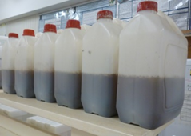
RESEARCH QUESTIONS AT LAB.
Elucidating drug resistance/stress response mechanisms of infectious pathogens at the system-wide level using mass spectrometry-based proteomics
Mycobacterium tuberculosis, bacterial infections
Candida albicans, Streptomyces cerevisae
Plasmodium falciparum
Bioassay-guided isolation of novel next generation bioactive compounds from fungal sources
Marine Endophytic fungi
Wood decay fungi
Soil Borne Fungi
Terrestrial endophytic fungi

Slide 5
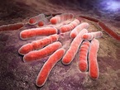
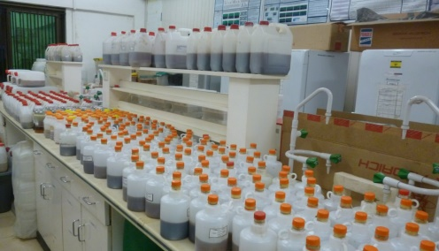
RESEARCH QUESTION (MPhil PROJECT)
Investigations into the mechanisms of anti-mycobacterial drug resistance using antipsychotic compounds.
Unique features of the Laboratory
Largest collection of fungal cultures in Ghana
Active extracts with cross bioactivity
Tubercle bacilli

Slide 6
UNIQUE SKILLS ACQUIRED
Extraction of secondary metabolites from fungal cultures
Microbiology techniques (culturing, transformation etc)
Kupchan Solvent partitioning
Partitioning of extracts into 7 different fractions
Preparative and Analytical Thin layer Chromatography (TLC)
For sub-fractionations of extracts

Slide 7
CHALLENGES WITH RESERACH
Ultra-high throughput screening technologies.
Need for LC systems and liquid equipment and complete set up for separation of organic compounds
Availability of equipment for system-wide analysis of stress-induced organisms (eg. Mass spectrometry).
Structural resolution and quantification techniques of extracts (Nuclear magnetic Resonance, HPLC)
Space

Slide 8
COLLABORATION
State-of-the-art high throughput screening
Current trends in structural elucidation approaches and techniques
Training and innovation

Slide 9


ACKNOWLEDGEMENTS
Superb contributions from MeBoP course coordinators and organizers.
Home institution (Department of Biochemistry, Cell and Molecular Biology, University of Ghana)
Peer Groups of MeBoP course, 2017,

Slide 10
THANK YOU FOR YOUR ATTENTION

